Slide 1
Public Health and Healthcare Response to Hurricane Harvey
Presentation to House Committee on Public Health and House Committee on Human Services
Dr. John Hellerstedt, Commissioner
November 1, 2017

Slide 2
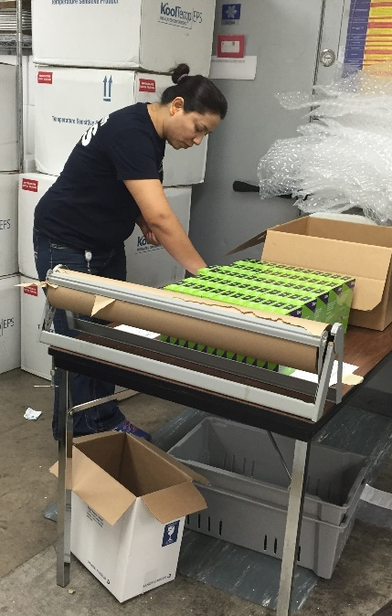
Presentation Overview
DSHS Responsibilities in Emergency Response
DSHS Hurricane Harvey Response Efforts
  Vector Control
  Immunizations
  Medical Evacuations
Public Health Recovery Efforts
  Food Safety
  After Action Review
Appendix

Slide 3
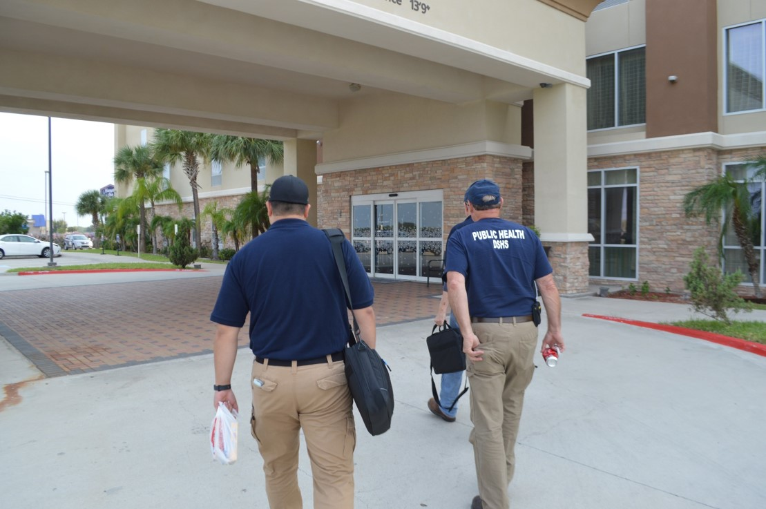
DSHS Responsibilities in Emergency Response

Slide 4
DSHS Responsibilities in
Emergency Response
DSHS responsibilities fall under the State of Texas Emergency Plan.
Emergency Support Function 8: coordinating public health and medical response during emergencies
Annex D: radiological emergencies
Healthcare
Public Health
Emergency Management
Public Health and Healthcare Preparedness

Slide 5
DSHS Responsibilities in Emergency Response
While emergency response begins at the local level, DSHS plays a vital role when:
  There is no local health department
  The response exceeds local capacity
  Large events involve multiple jurisdictions
  Response involves areas with no local component
DSHS operates the State Medical Operations Center (SMOC)
  SMOC operates in coordination with the State Operations Center (SOC) operated by the Texas Division of Emergency Management (TDEM).
Personnel and resources from across DSHS are utilized to respond to an emergency.

Slide 6
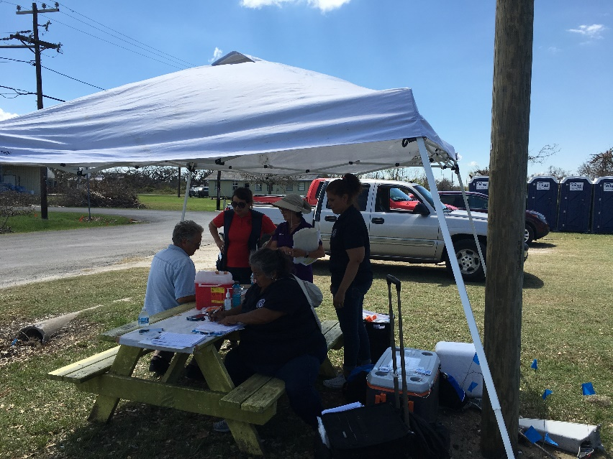
DSHS Hurricane Harvey Efforts

Slide 7
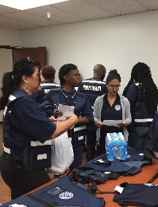
DSHS Hurricane Harvey Efforts
DSHS efforts by the numbers:
  689 DSHS staff involved in response
  149 DSHS personnel staffed SMOC
  990 medical response missions
  3,200 medical patient evacuations
  1,800 patients treated by mobilized medical units
  142 patients transferred
  70,000 vaccines distributed
  6,765,971 acres treated for mosquito control
Total DSHS as of September 20th: $41,218,005

Slide 8
DSHS Hurricane Harvey Efforts
DSHS Hurricane Harvey efforts included a diverse array of public health activities across the state to assist people impacted by the storm.
Some of these activities include:
Support medical personnel and assets for medical evacuations and shelters
Activate aerial and ground spraying to control mosquito populations
Provide vaccine and medication for responders and impacted individuals
Maintain situational awareness and provide assistance to healthcare facilities as needed
Provide public health education and outreach
Identify and monitor public health risks

Slide 9
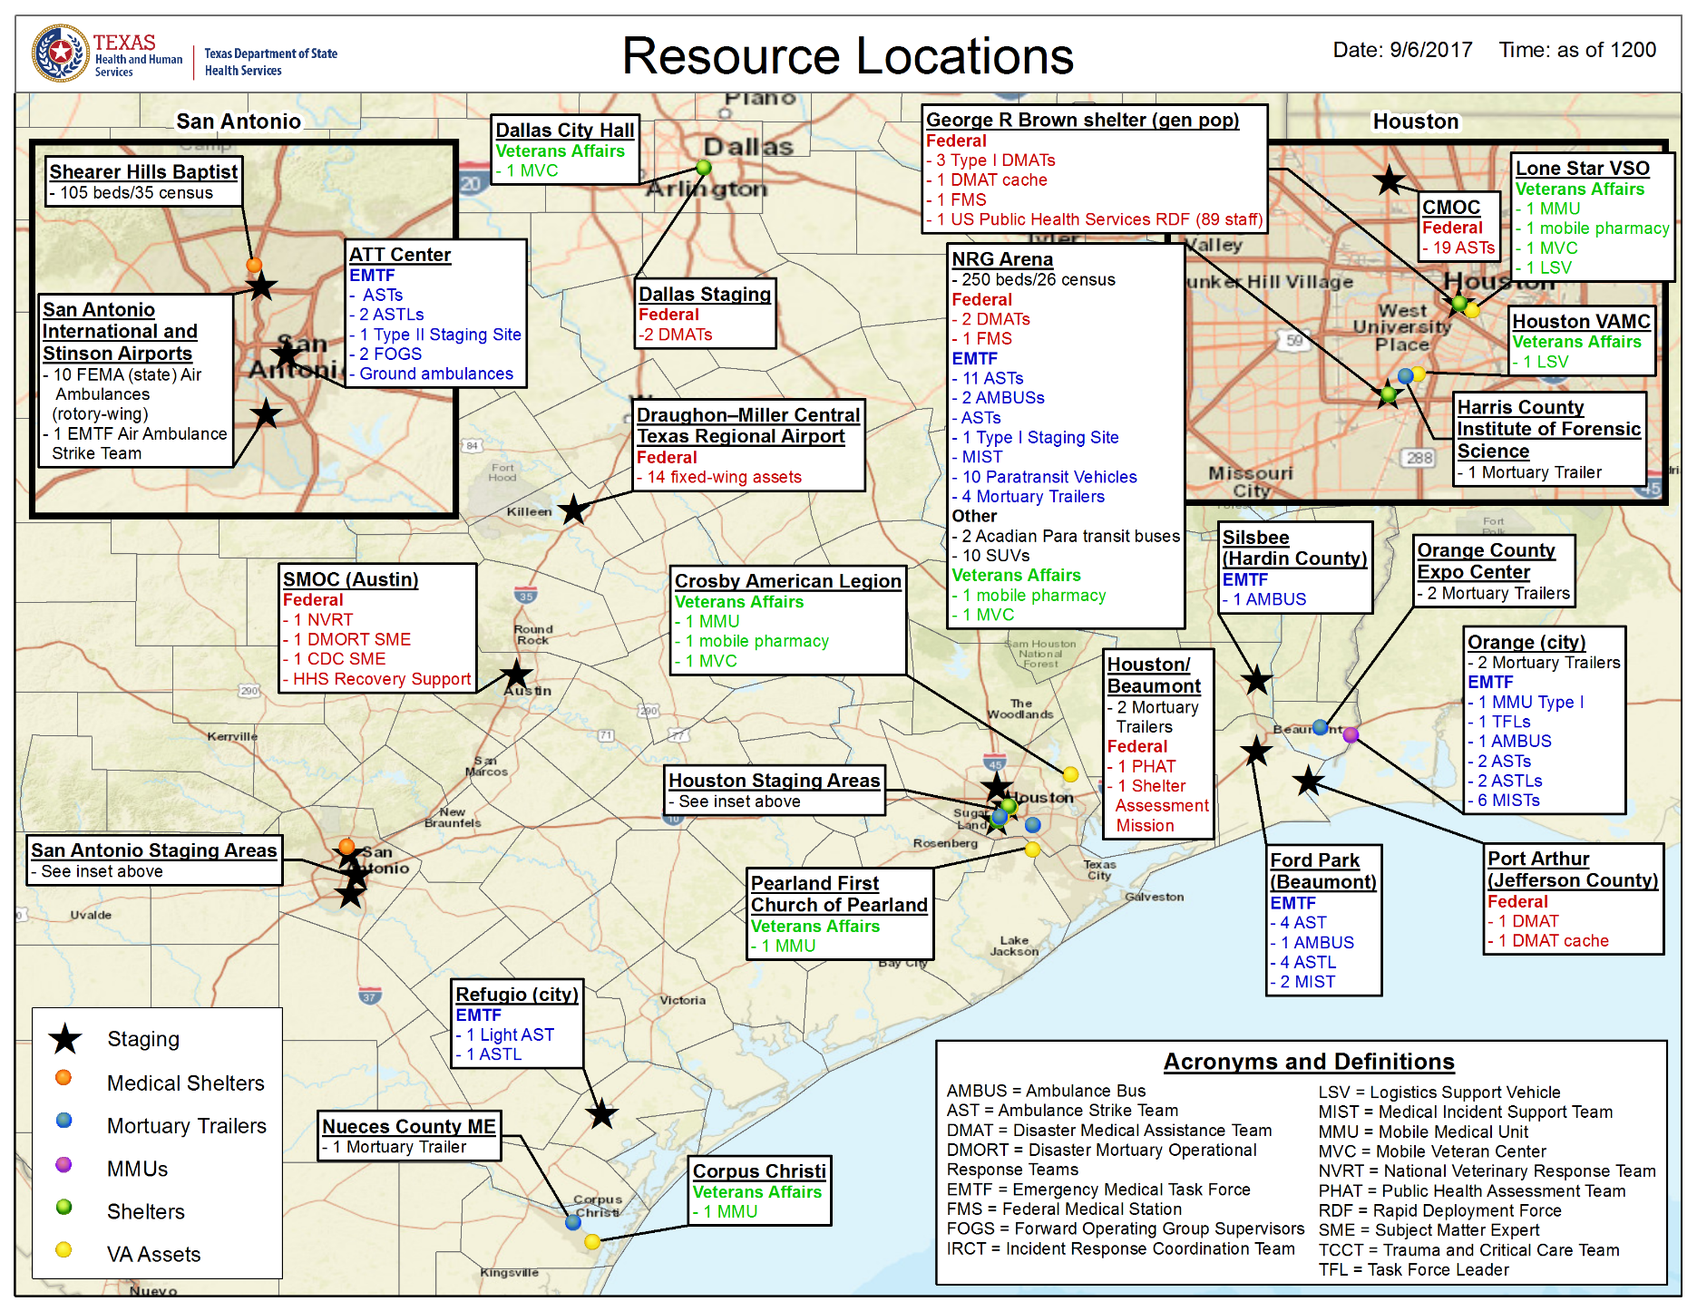

Slide 10
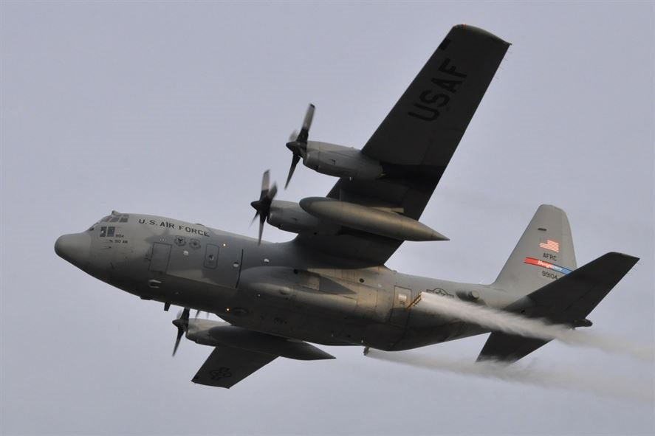
Public Health Recovery Efforts

Slide 11

Public Health Recovery Efforts
DSHS is engaged in ongoing public health recovery efforts.
Food Safety: The Texas Rapid Response Team (TRRT) has been activated to monitor and respond to any food-related incidents
Impact Assessment: Working with locals to assess impact to public health and medical infrastructure, public health issues relating from the disaster, identify gaps, and provide support as appropriate
After Action: Identifying lessons learned to produce a comprehensive statewide Public Health and Medical After Action Report and Improvement Plan
Asset Recovery: Assessing resources expended during the emergency in order to replace and repair equipment in preparation for future responses
Reimbursement: Working with entities involved in response to ensure documentation necessary for Federal Emergency Management Agency (FEMA) reimbursement has been completed
Data and Statistics: Analyzing death certificates, reviewing media reports, and contacting medical examiners and justices of the peace to identify hurricane-related deaths

Slide 12
After Action Review Timeline
Emergency Medical Task Force hot wash
DSHS executive team hot wash
Sept. 21
State Medical Operations Center hot wash
Oct. 30
Texas Hospital Association Lessons Learned Forum
DSHS regional director hot wash
Sept. 26-27
Oct. 5
Oct. 24
Oct. 31
DSHS agency hot wash
TBD
Regional Health Medical Operations Centers (RHMOCs) hot wash
Nov. 14
Immunizations hot wash
Nov. 16
Vector control hot wash
On-going
SMOC Section Chiefs 1-on-1 hot washes
Early 2018
Completion of the final Hurricane Harvey Improvement Plan

Slide 13
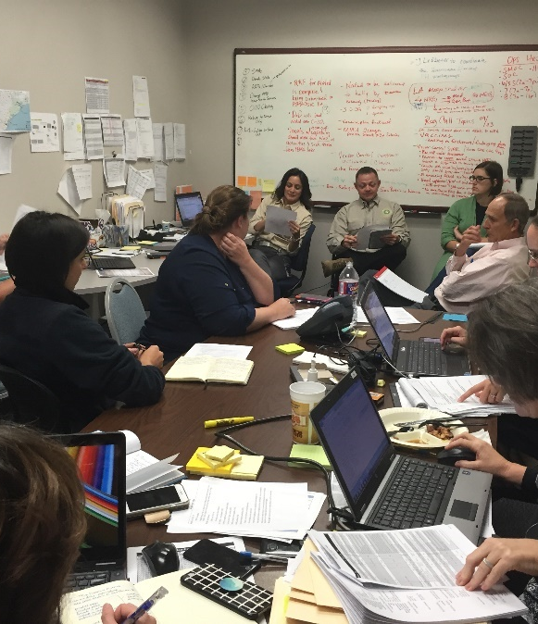
Preliminary After Action Areas of Focus
Medical sheltering
Medical evacuation and transportation
Patient repopulation
Resource staging and deployment
Immunizations response
Vector control
Medical volunteer and donation management
Public health surge capacity
Health impact tracking

Slide 14
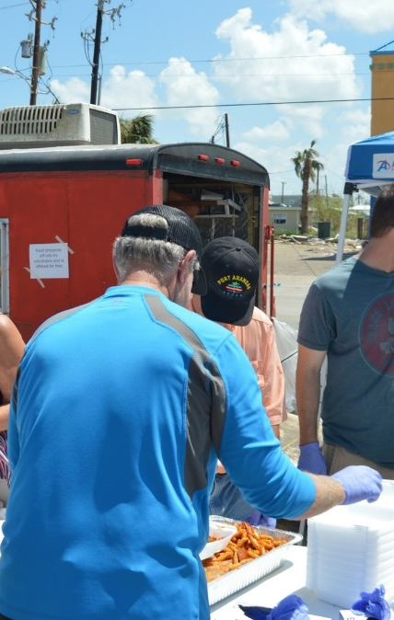
Appendix
Preparedness Efforts
Response Efforts
Recovery Efforts
Hurricane Harvey Expenditures and Funding Sources
Public Health Emergency Preparedness
Hospital Preparedness Program

Slide 15
Preparedness – DSHS Hurricane Harvey Efforts
Before each hurricane season, DSHS updates plans, procedures, and staff training to ensure readiness.
  Conducted 8 day, full-scale evacuation exercise in June 2017 in conjunction with TDEM
Raising public awareness about how to prepare for a disaster increases personal readiness.
  http://www.texasprepares.org/
Mobilizing assets before the hurricane makes landfall is important to ensure resources are in place for response.

Slide 16
Response – DSHS Hurricane Harvey Efforts
Deployed medical personnel to assist with medical evacuations and to support general population shelters:
  795 Emergency Medical Task Force (EMTF) personnel
  100 EMTF ambulances
  13 EMTF ambuses
  18 Disaster Medical Assistance Teams
  58 air ambulances
3 mobile medical units to treat, stabilize, and transport individuals
3 medical shelters for evacuees with medical needs

Slide 17
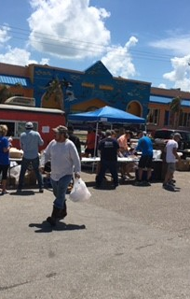
Response – DSHS Hurricane Harvey Efforts
Requests from local entities for vaccine were processed
  As of September 22nd, provided over 70,633 doses to the locals
Sanitarians were deployed to impacted areas to help provide guidance on food safety
Maintain situational awareness and provide assistance to healthcare facilities, as needed
Support aerial and ground spraying to control mosquito populations

Slide 18
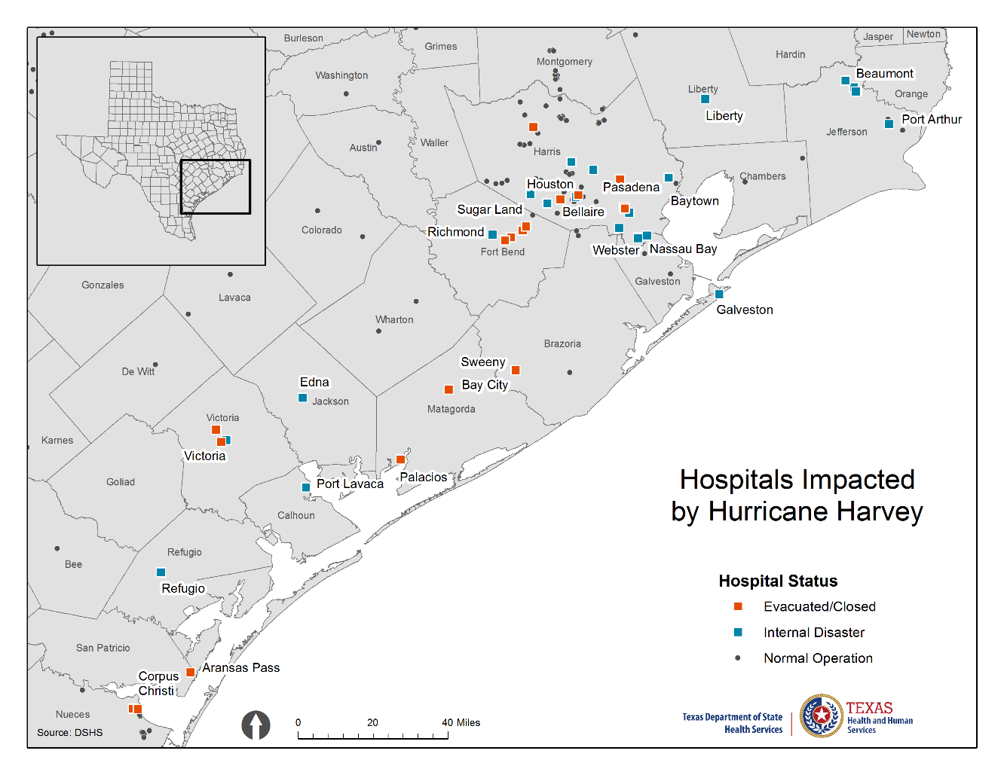
Response – DSHS Hurricane Harvey Efforts
Evacuated/ Closed: 20
Internal Disaster: 25

Slide 19
Response – DSHS Hurricane Harvey Efforts
The Governor’s office has granted several DSHS requests to waive certain rules and statutes to facilitate response and recovery:
  Mold Remediation
  Food Donation
  Animal Shelters
  Grace Periods for License Deadlines/Fees
  Delayed Infection Reporting by Facilities
  Asbestos
  Vital Statistics Fees
  Alternate Potable Water Sources
  Verification of Immunizations for School Enrollment

Slide 20
Recovery – DSHS Hurricane Harvey Efforts
Counties sprayed: 29
Approximate number of acres sprayed:6,765,971

Slide 21
Recovery – DSHS Hurricane Harvey Efforts
Provide public health education and outreach for cleanup and recovery
Collect and analyze hurricane-related health data to assess the public health impacts from the storm
  Identify hurricane-related deaths
  Modify the Texas Pregnancy Risk Assessment Monitoring System
  Collaborate to analyze data on water, soil, and air quality
Perform public health surveillance to monitor for infectious diseases
Identifying and monitoring public health risks post-event

Slide 22
Hurricane Harvey Expenditures and Funding Sources
Hurricane Harvey Estimated Expenditures
Personnel, Supplies, and Logistics | $2,834,439
Contract - Emergency Medical Task Force/Regional Advisory Council Resources | $12,254,754
Contract – Vector Control | $11,716,090
Contract – BCFS Medical Shelter | $7,560,000
Contract – FEMA Ambulances* | $6,600,000
Contract – Mortuary Trailers | $160,320
Contract – Oxygen | $44,370
Total | $41,218,005
Hurricane Harvey General Revenue Funding Sources
Original Funding Identified – Health Data and Analysis, Immunizations, Laboratory, Mental Health State Hospitals (AY 17) | $2,800,000
Base Capital Lapses (AY 17) | $1,178,305
25% Capital Lapse (AY 17) | $401,836
Unobligated GR (AY 17) | $4,672,567
HHS Funding (AY 17) | $7,448,970
Delay Paying HHS System Expenses (AY 18) | $15,613,806
Public Health Revenue Accounts (AY 18) | $12,604,199
Total | $44,719,683
* It is anticipated the $6.6 M for FEMA ambulances will be paid directly by FEMA

Slide 23

Funding for Public Health Response
There is no specific funding stream for response.
DSHS uses various budget mechanisms to manage cash flow during a response.
  Payments are due before potential federal reimbursement is received.
FEMA reimbursement cannot always be expected, and the parameters of reimbursement are unpredictable.
  100 percent reimbursement is the exception to the rule.
  Costs may fall outside the time period for reimbursement.

Slide 24
Funding for Public Health Preparedness
General Revenue funding is not specific to preparedness. Rather, it maintains the public health infrastructure necessary for response.
State Funds by Strategy | FY 2018-19
A.1.1: Public Health Preparedness &Coordinated Services | $28,607,815
A.2.3: Infectious Disease Epidemiology, Surveillance, and Control | $22,772,131
A.4.1: Laboratory Services | $83,449,761
Total | $134,829,707

Slide 25
Funding for Public Health Preparedness
A federal cooperative agreement funds two public health preparedness programs:
Public Health Emergency Preparedness (PHEP)
Hospital Preparedness Program (HPP)
Preparedness Federal Funding Programs | FY 2018-19 Totals
Hospital Preparedness Program (528 – HPP) | $32,353,268
Public Health Emergency Preparedness (531 – PHEP) | $75,773,702
Public Health Preparedness Response Zika (775-PHPR) One-time | $950,000
Hospital Preparedness Program Ebola Supplemental (752 – Part A) One-time | $1,700,000
Hospital Preparedness Program Ebola Supplemental (761- Part B) One-time | $500,000
Total | $111,276,970

Slide 26
Public Health Emergency Preparedness (PHEP)
Administered by the Centers for Disease Control and Prevention (CDC)
Focus is on community preparedness to prevent, respond to, and rapidly recover from all public health threats.
Key components:
  Epidemiology and surveillance
  Lab Response Network (LRN) – biological and chemical
  Rapid dispensing of medical countermeasures
  Responder safety and health
Funds support local health departments, health service regions, statewide projects, and DSHS central office.

Slide 27
Public Health Emergency Preparedness Funding: 2008-2017

Slide 28
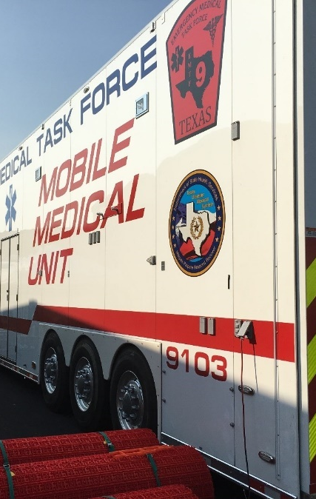
Hospital Preparedness Program (HPP)
Administered by the U.S. Department of Health and Human Services Office of the Assistant Secretary for Preparedness and Response (ASPR).
HPP funds support equipment and trained personnel:
  Ambulance bus (AMBUS) equipment
  Mobile medical units
  Ambulance strike teams
  Physicians, nurses, and paramedics
Funds used to support healthcare preparedness coalitions, statewide projects, and the DSHS central office.

Slide 29
Hospital Preparedness Program Fiscal Years 2008-2017

Slide 30
Thank you

